Slide 1



A National Approach to Capturing the Value & Impact of Health Libraries
Adapted from EAHIL presentation,
12 – 16 June 2017 / Dublin Castle / Ireland
Susan Smith
Mid Cheshire Hospitals NHS Foundation Trust
Doug Knock
King’s College Hospital NHS Foundation Trust
Dom Gilroy
Healthcare Libraries Unit North

Slide 2
What is covered in this presentation?
Development of the Value & Impact Toolkit
Critical incident technique & use of tools
National roll-out of data collection
Submitting and accessing impact case studies
What are you measuring for whom?
The logic model

Slide 3
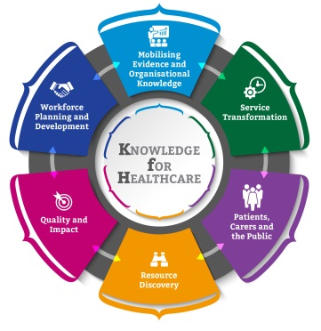
Knowledge for Healthcare (KfH)
Formed in May 2015, this was the first task and finish group for KfH, as part of theQuality & Impact work stream
Aim of creating a suite of tools to help better understand the value and impact of Library & Knowledge Services (LKS)
Members of the group reflected the broad spectrum of the NHS services, geographical spread and different job roles
A reference group of known experts & interested people was created to test thinking

Slide 4
The Brief
Original brief
Refreshing and renewing the existing impact toolkit
Ensure suitability for use in identifying non-clinical impacts
Broader goal
Finding a systematic way to capture and record LKS impact for escalation to national LKS Leads
Managers can use the case studies to share success stories and create business cases
Metric for success
Increase in use of the refreshed Impact Toolkit:
used by 95% of services by 2020

Slide 5
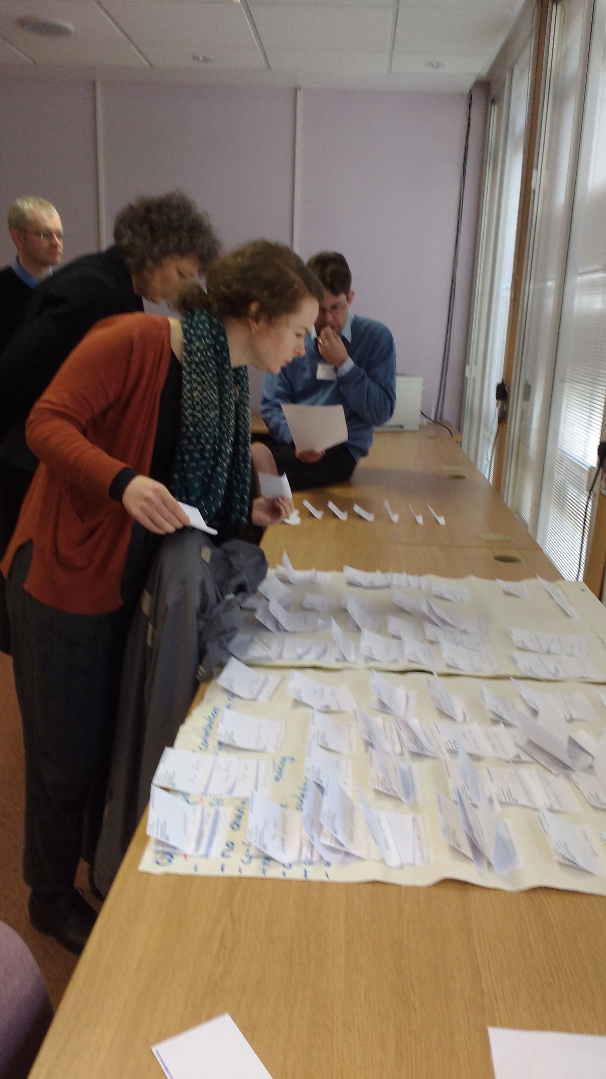
Planning
Scoping literature search
National survey to establish the current position of impact work on a local level; to identify methodologies and tools used; to assess requirements of the new toolkit
Analysis of fully compliant LQAF submissions relating to impact
Thorough and meticulous mapping of the outcomes of the above

Slide 6
What we found
136 services (63%) out of the 215 services identified in KfH responded
95.5% of responding services collect impact information
25 fully compliant impact sections of the annual Library & Quality Assurance Framework were collected and analysed
We determined the need for 3 specific tools – a quick survey, in-depth interview questionnaire and a case study template
Questions and impacts used in the survey are tried and tested in evidence and cross-referenced with the group remit

Slide 7
Critical Incident Technique
All tools developed to be used with the Critical Incident Technique
Impact of a single particular incident or interaction with the LKS e.g. training session, use of study space
Focused, accurate (Urquhart, 2001) less subject to recall bias, tangible

Slide 8
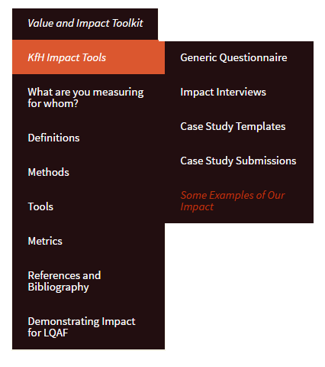
The Survey
Generic survey
Creating consistency
Quick & easy to use
Can be used as a scoping tool alongside the critical incident technique for more in-depth interviews to ‘dig deeper’
http://kfh.libraryservices.nhs.uk/

Slide 9

Collating the questionnaire
We know different libraries collect the quantitative impact data in different ways (hence different colours of small Gummi bears):
Through the year (e.g. follow up after every training session, or every literature search)
Some do an annual survey
Some follow-up on specific services, or new services
Some do nothing- they don’t have the capacity
We want consistency to create a national perspective
(Large Gummi bear of impact)

Slide 10
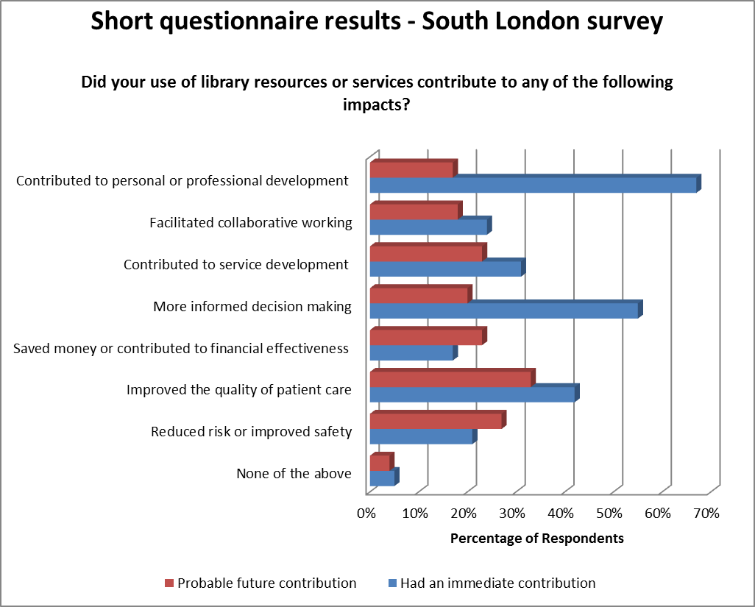
Example of what we hope to achieve
Impact survey conducted in South London 2016-17
1010 respondents
Focused on the impact of a specific use of service

Slide 11
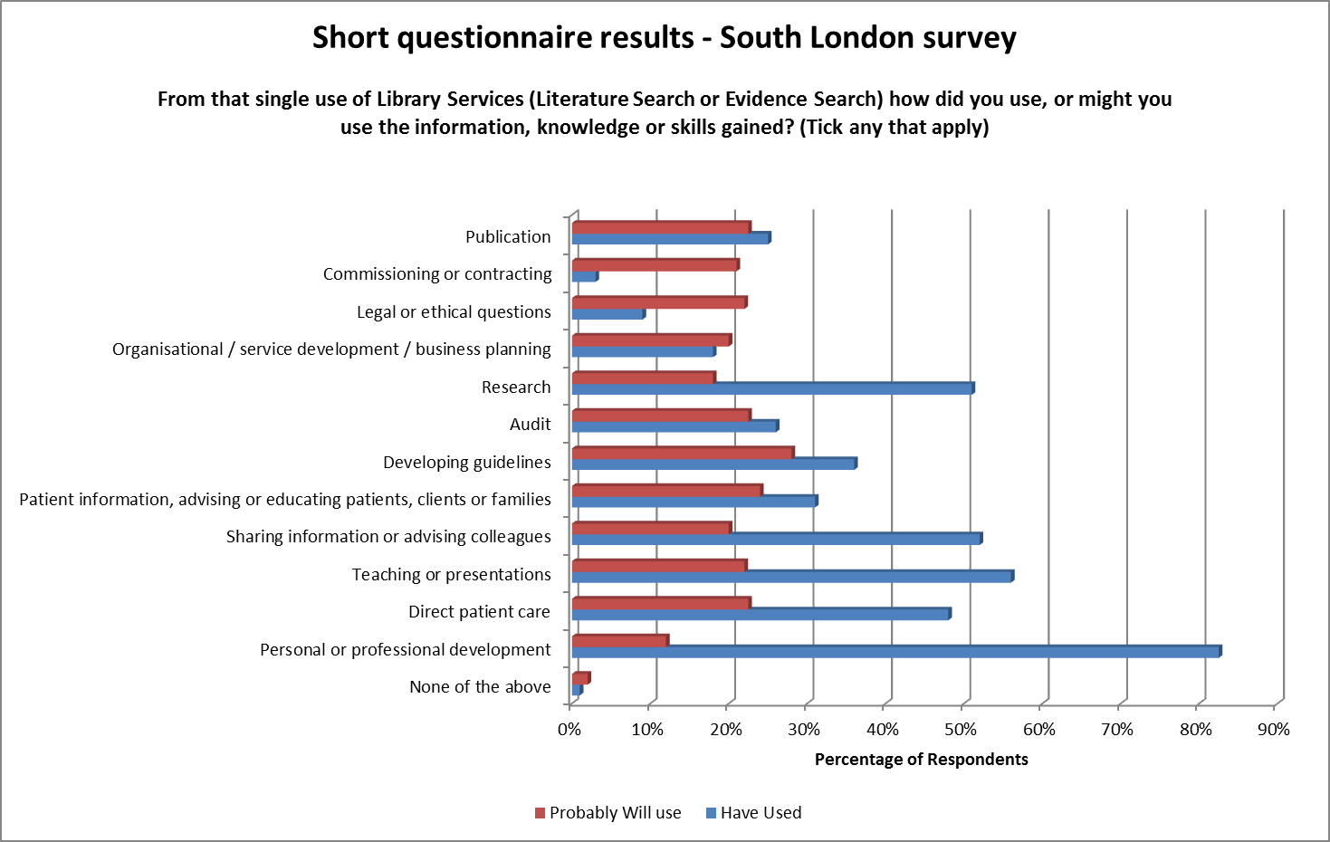
Can be used to break down impact of specific interventions / critical incidents and the use of the information / knowledge or skills gained – 320 respondents selected Literature / Evidence Search

Slide 12
The in-depth analysis
Impact interview templates
Case Study templates and guidance
Can use survey or personal knowledge to identify instances
Conduct in person, by email or over the phone
http://kfh.libraryservices.nhs.uk/

Slide 13
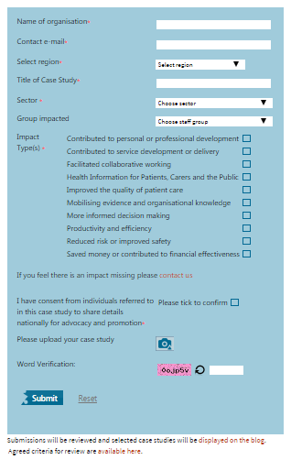
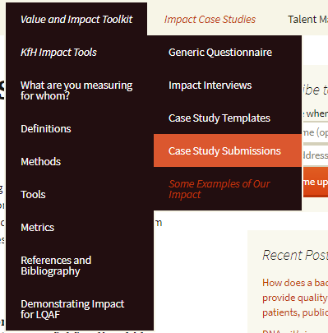
Case study submissions
Anyone can submit a case study and download the full collection of submissions to search
http://kfh.libraryservices.nhs.uk/

Slide 14
Case study submissions
The impact types on the case study submission may differ from the questionnaire, as this tool is guided by the current priorities of the LKS Leads.
There are 6 areas of impact deemed high value for targeting messages for high-level champions.
Money e.g. procurement, length of stay, standardisation and economies of scale
Quality e.g. clinical care, patient experience, decreased litigation and increased patient safety
Public health / safe care
Efficiency e.g. time saving
Workforce and learners e.g. new roles, student experience, revalidation
Service improvement e.g. innovation, research, collaboration

Slide 15
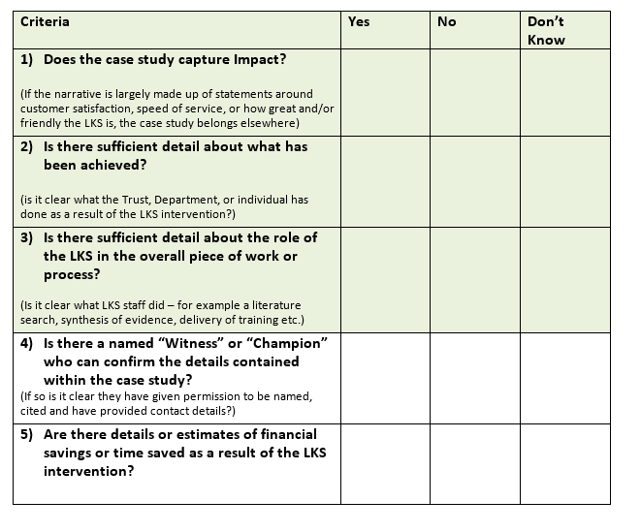
Case study submissions
Review use this framework to evaluate for:
Addition to database
Escalation to LKS Leads
Rejected submissions will receive feedback and suggestions for amendment
Case studies will also be collected from LQAF submissions

Slide 16
What are you measuring for whom?
Alison Brettle (University of Salford) was commissioned to develop a tool which could help librarians identify which is the best tool to use for the job.
A mapping matrix was developed to help recommend the tools to use when targeting specific stakeholders.
It is also an excellent way to navigate the toolkit
Notes:
The second part of the project was a piece of work we commissioned Alison Brettle from Salford University to deliver for us. This was based on her own expertise as well as some of the evidence generated by the Task and Finish Group.
We anticipate that this may be of most interest to colleagues here at EAHIL
It was recognised that many people, in both their LQAF submissions and in their responses to our questionnaires were confusing Impact measures with other measures such as User Satisfaction. Therefore the toolkit aims to help users to identify the type of evidence they need to gather depending on what they wish to use it for and the type of stakeholders they wish to use the evidence with. Some of these techniques may be more appropriate to local reporting of impact.
The key to accessing the tools is a mapping matrix. The matrix considers the different stakeholders, what each individual stakeholder is interested in and recommends suitable tools which can be used.

Slide 17
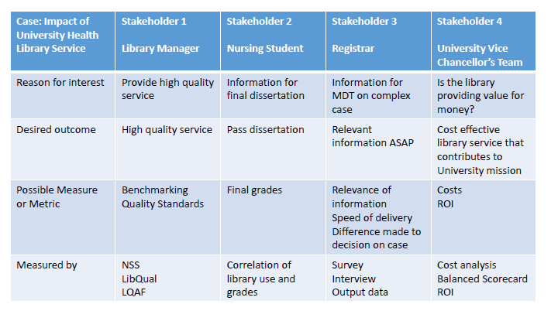
What are you measuring for whom?

Slide 18
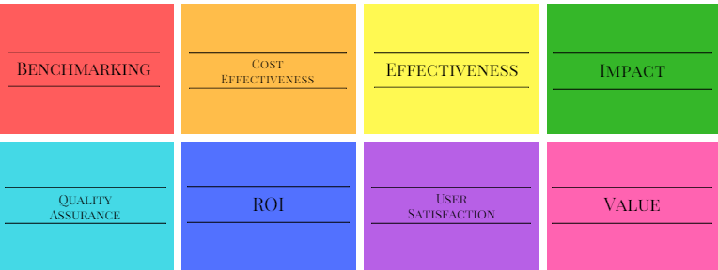
Methods
Definitions, research and tools of related methodologies can also be accessed on the toolkit:

Slide 19





Making the case for health libraries
#milliondecisions
www.cilip.org.uk/amilliondecisions

Slide 20
The logic model
Personal or professional development
Direct patient care
Publication
Research
The logic model is another tool which can be used to demonstrate the longer term results of an impact evaluation of the contribution of librarians to the service.
From this you can gain a snap shot of the outcomes which are important to your organisation.
It considers the following:
What service does the library provide
What output will the user develop as a result of this service
What are the outcomes (short, medium and long term)

Slide 21
Input
Activity
Output
Outcomes
(short, medium, long)
Personal or professional development
Direct patient care
Publication
Research
Individuals
Contributed to personal or professional development
More informed decision making
Improved quality of patient care
Facilitated collaborative working
Current awareness or alerts
Literature search or evidence search
Training or learning
Supply of an article, book or document
Journal club
Outreach
Service
Sharing information or advising colleagues
Developing guidelines, pathways or polices
Audit
Service or Organisation
Reduced risk or improved safety
Changed service development or delivery
Saved money or contribute to financial effectiveness

Slide 22
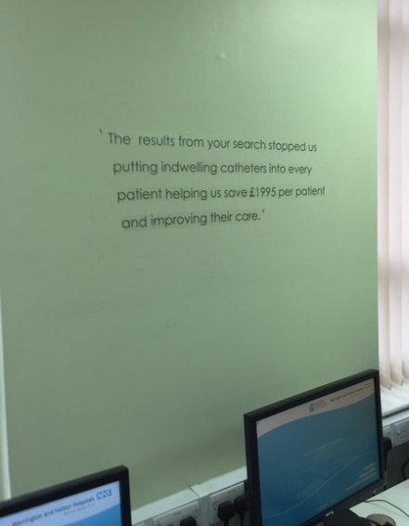

You have the evidence - now what?
Use the impact to raise the profile of your service!
Why not add to: annual reports, committee meetings, promotional conversations, social media
Align to your organisational needs!
https://maptoolkit.wordpress.com

Slide 23
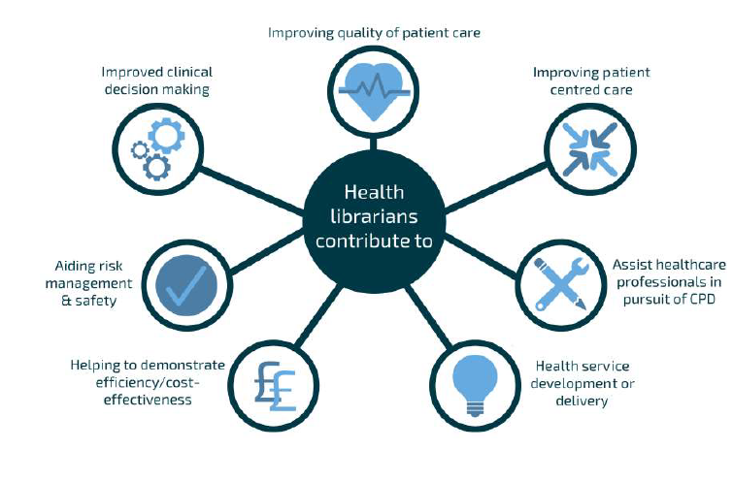
Major outcomes in the NHS

Slide 24

Major outcomes in Higher Education

Slide 25

Questions & comments
What do you think?
http://kfh.libraryservices.nhs.uk/value-and-impact-toolkit

